Slide 1

A Deep Dive into Containerized Model Serving with FastAPI
20220628 - A Deep Dive into Containerized Model Serving with FastAPI
PyLadies Amsterdam
June 28, 2022
Nikki van Ommeren
Karlijn Schipper
20220628 - A Deep Dive into Containerized Model Serving with FastAPI

Slide 2

Agenda
Who are we?
The case: A Deep Dive into Containerized Model Serving with FastAPI
20220628 - A Deep Dive into Containerized Model Serving with FastAPI

Slide 3


Who are we?
Nikki van Ommeren
Karlijn Schipper
20220628 - A Deep Dive into Containerized Model Serving with FastAPI

Slide 4
Nikki van Ommeren
Data scientist at Adyen
Enjoys board games, running, cycling
20220628 - A Deep Dive into Containerized Model Serving with FastAPI

Slide 5
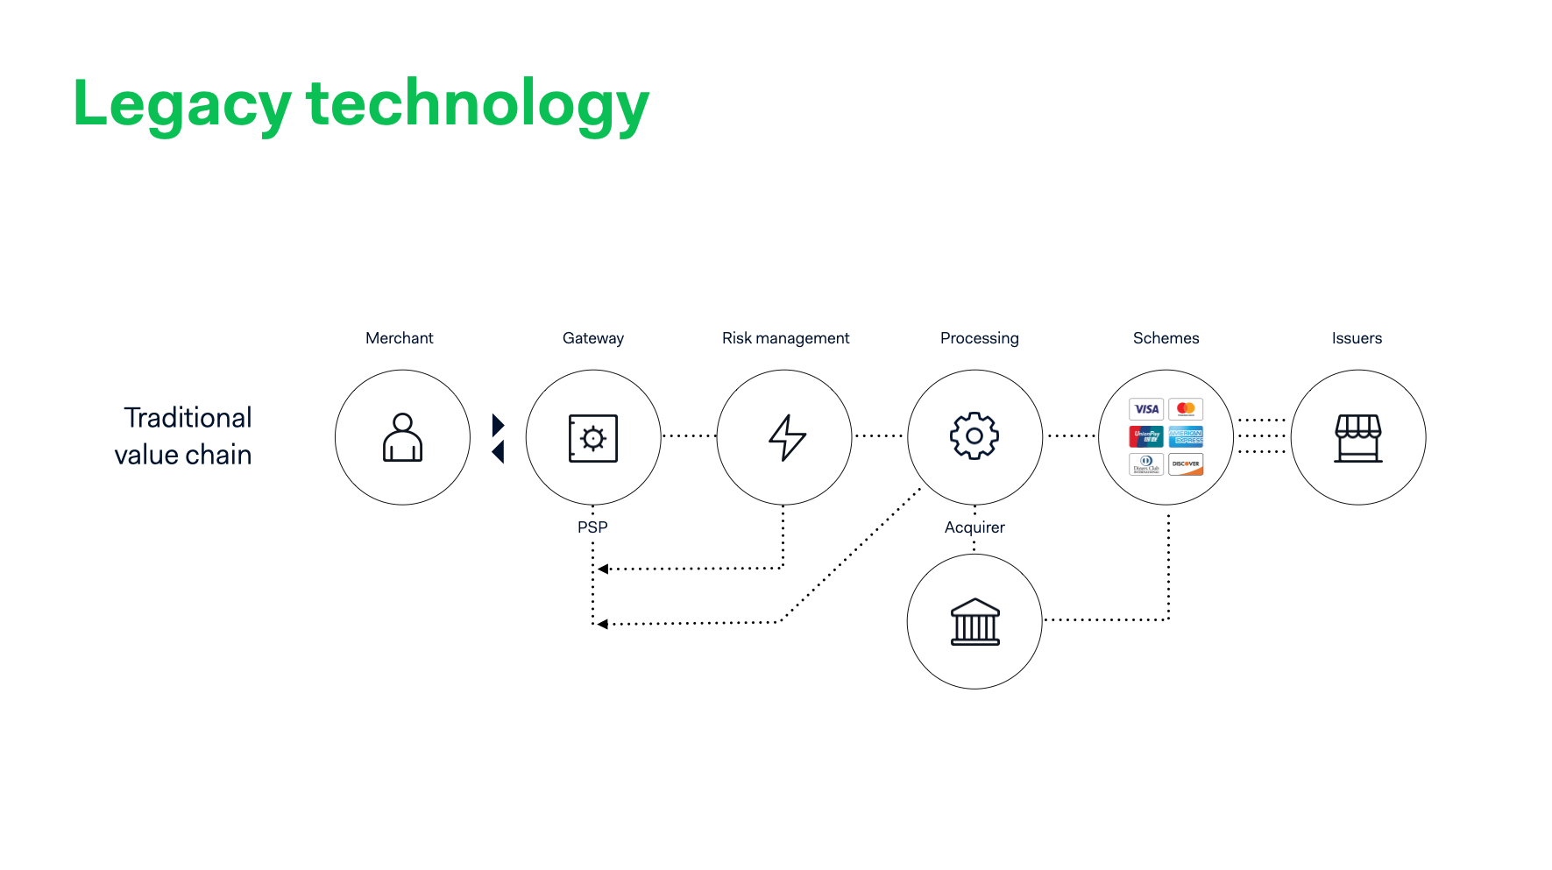
20220628 - A Deep Dive into Containerized Model Serving with FastAPI

Slide 6
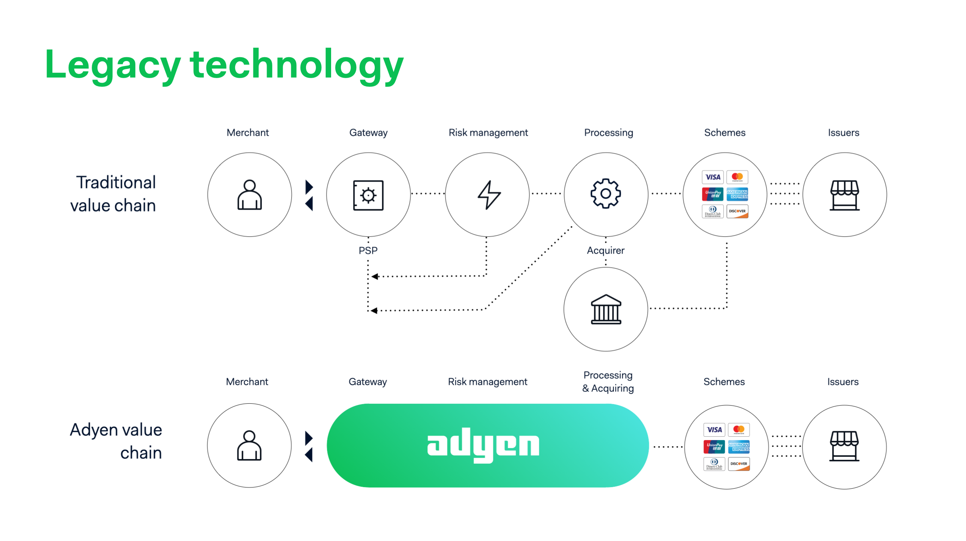
20220628 - A Deep Dive into Containerized Model Serving with FastAPI

Slide 7
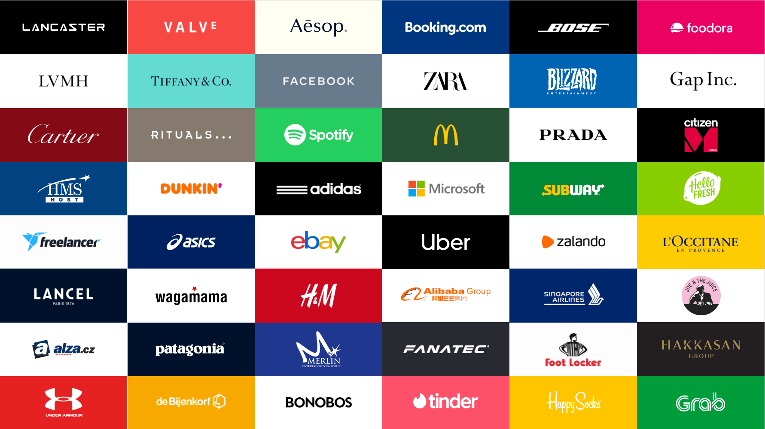
Adyen

Slide 8




Karlijn Schipper
Machine Learning Engineer @
20220628 - A Deep Dive into Containerized Model Serving with FastAPI

Slide 9







Vantage AI delivers hands-on customisation in the field of ML and AI to solve business problems
2-year training program
6-12 months assignments
Weekly trainings on Friday
Added value of our sister company BDR:
Training
Mentorship program
Knowledge sessions
After this program, we transition to (BDR)
20220628 - A Deep Dive into Containerized Model Serving with FastAPI

Slide 10





Fun stuff
Questions? Find me, or Vantage AI on LinkedIn via this QR code:
20220628 - A Deep Dive into Containerized Model Serving with FastAPI

Slide 11
Agenda
Who are we?
The case: A Deep Dive into Containerized Model Serving with FastAPI
20220628 - A Deep Dive into Containerized Model Serving with FastAPI

Slide 12
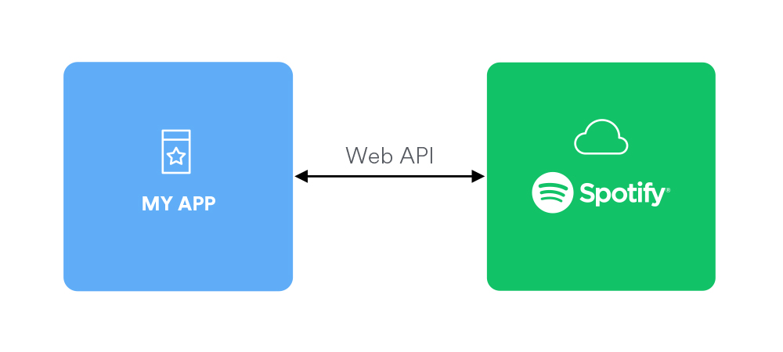

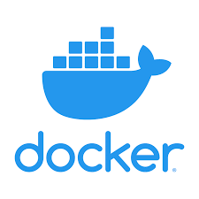
The goal of this workshop is to create an end-to-end Machine Learning solution that recommends Spotify songs based on your personal music taste
Model
Get spotify data
FastAPI
20220628 - A Deep Dive into Containerized Model Serving with FastAPI

Slide 13
Case overview
Part 0 – Preparation
Part 1 - Create Dockerfile and bash script
Part 2: Create FastAPI
Part 3: Response model & Error handling
20220628 - A Deep Dive into Containerized Model Serving with FastAPI

Slide 14
Part 0 – Preparation
Create an .env file in the workshop folder
Fill this .env file in with your Spotify credentials
You can get these credentials via your own app (https://developer.spotify.com/dashboard/applications)
20220628 - A Deep Dive into Containerized Model Serving with FastAPI

Slide 15

Multiple problems can arise if you want to deploy your model
Where to put files on the server?
Different dependencies for the server OS are installed
What other processes etc. are running on the server during your installation?
Different OSs are used when developing the product
What happens when the server changes?
20220628 - A Deep Dive into Containerized Model Serving with FastAPI

Slide 16
Meet Docker
Docker is a framework for containerization
Apps run within a virtual container, separated from other apps
Docker containers run the same on any host machine: they have their own virtual OS installed
Enables microservice architectures: lots of different containers with simple tasks talking through each other through API’s
20220628 - A Deep Dive into Containerized Model Serving with FastAPI

Slide 17
Main benefits of Docker
Containers run the same on any machine
Easy to use
Quickly build and test applications
Lightweight and quick: very little overhead
Enables better scalability
Tools like Kubernetes can be used to manage containers in production environments
20220628 - A Deep Dive into Containerized Model Serving with FastAPI

Slide 18
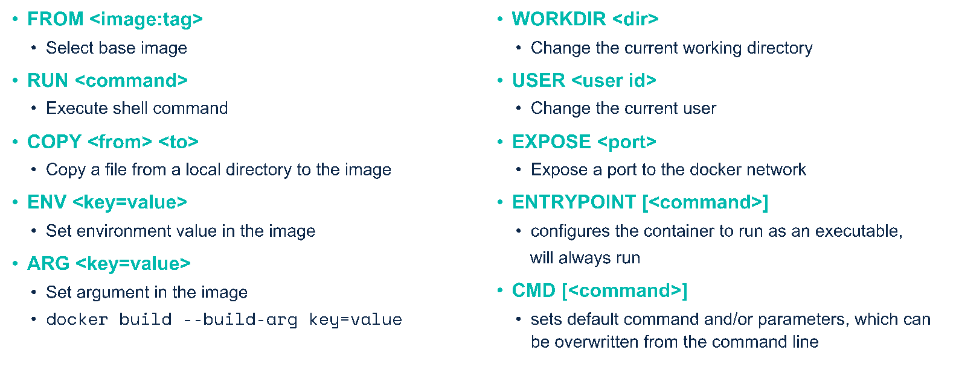
Dockerfile commands
20220628 - A Deep Dive into Containerized Model Serving with FastAPI

Slide 19
Docker commands
docker build –t <tag_name> .
docker run –p 8080:8080 –v <directory>:<directory> <tag_name> bash –c “command”
docker tag <tag_name> <dockerhub_repo>
docker image push <dockerhub_repo>
20220628 - A Deep Dive into Containerized Model Serving with FastAPI

Slide 20

Part 1: Create a Docker container that prints your most listened song
Complete the Dockerfile
Complete the bash file that builds a Docker image and runs the container
Run the bash file
Authenticate with Spotify API
20220628 - A Deep Dive into Containerized Model Serving with FastAPI

Slide 21
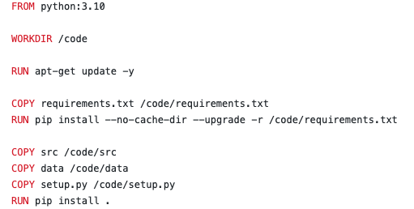
Solutions - Dockerfile
20220628 - A Deep Dive into Containerized Model Serving with FastAPI

Slide 22
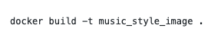
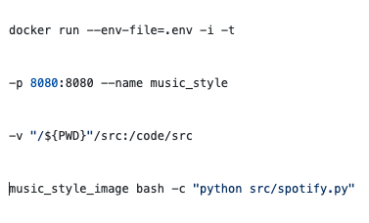
Solutions – run_endpoints.sh
20220628 - A Deep Dive into Containerized Model Serving with FastAPI

Slide 23
What is an API?
Lets applications talk to each other
You can use API’s to:
Get model predictions
Get Spotify data
Send data to your SQL server
Today we’re making an API to serve a ML model
20220628 - A Deep Dive into Containerized Model Serving with FastAPI

Slide 24
What is an API? (II)
Representational State Transfer Application Program Interface
Allows applications to talk to each other over the internet (with http)
Different kinds of requests (API calls):
GET request: gets information from the API
POST requests: sends information and receives a result
PUT/PATCH are used for replacing or updating information
DELETE
20220628 - A Deep Dive into Containerized Model Serving with FastAPI

Slide 25
Return codes
REST API’s work over http, and therefore use http status codes:
200 and above: Succesfull responses
200: OK
201: Created
300 and above: Redirection
400 and above: Client errors:
400 bad request, most generic error
401: Unauthorized
404: Not found
500 and above: Server errors:
500: Internal server error
503: service unavailable, etc.
20220628 - A Deep Dive into Containerized Model Serving with FastAPI

Slide 26
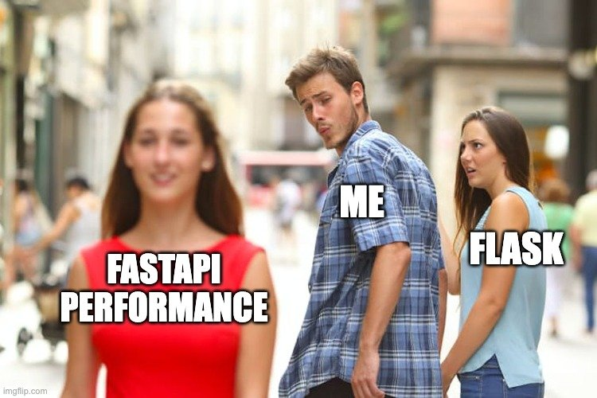
20220628 - A Deep Dive into Containerized Model Serving with FastAPI

Slide 27
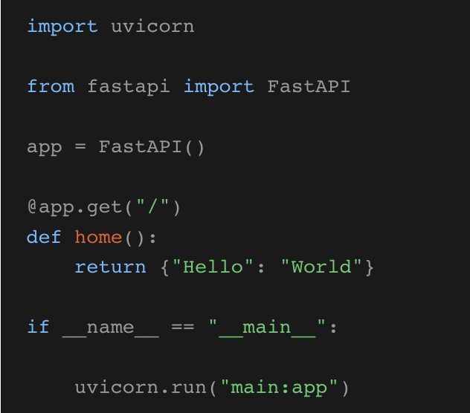
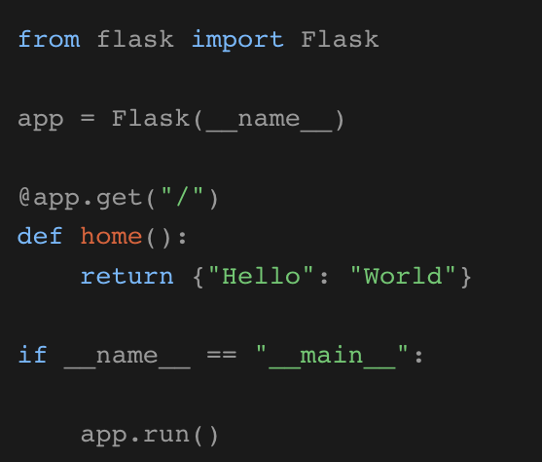
FastAPI vs. Flask
GET&POST requests are very similar
20220628 - A Deep Dive into Containerized Model Serving with FastAPI
Notes:
https://developer.vonage.com/blog/21/08/10/the-ultimate-face-off-flask-vs-fastapi

Slide 28
FastAPI vs. Flask
FastAPI
Automatic, interactive documentation
In-house data validation with Pydantic
Is asynchronous - no need to wait for other request to be completed. Flask is synchronous
Flask
Proven and well-tested solution
For web-development: Flask automatically looks for a templates folder where you can display your variables
20220628 - A Deep Dive into Containerized Model Serving with FastAPI
Notes:
https://developer.vonage.com/blog/21/08/10/the-ultimate-face-off-flask-vs-fastapi
Uses hot reloading, meaning your code changes are immediately visible.

Slide 29

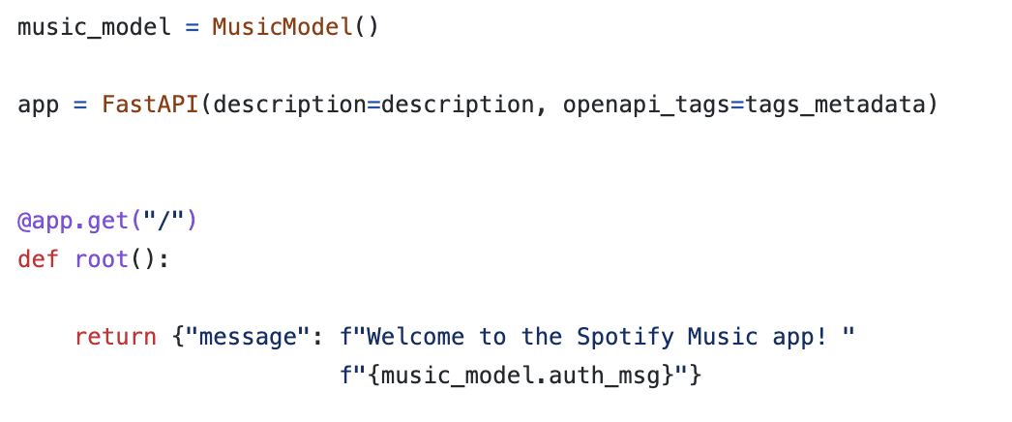
Part 2: Create FastAPI
20220628 - A Deep Dive into Containerized Model Serving with FastAPI

Slide 30
Part 2: Create FastAPI
Object created in main.py
uvicorn src.main:app --host 0.0.0.0 --port 8080 --reload --debug
Refers to file main.py
Makes sure the server restarts after code changes
20220628 - A Deep Dive into Containerized Model Serving with FastAPI

Slide 31
Part 2: Create FastAPI
20220628 - A Deep Dive into Containerized Model Serving with FastAPI

Slide 32
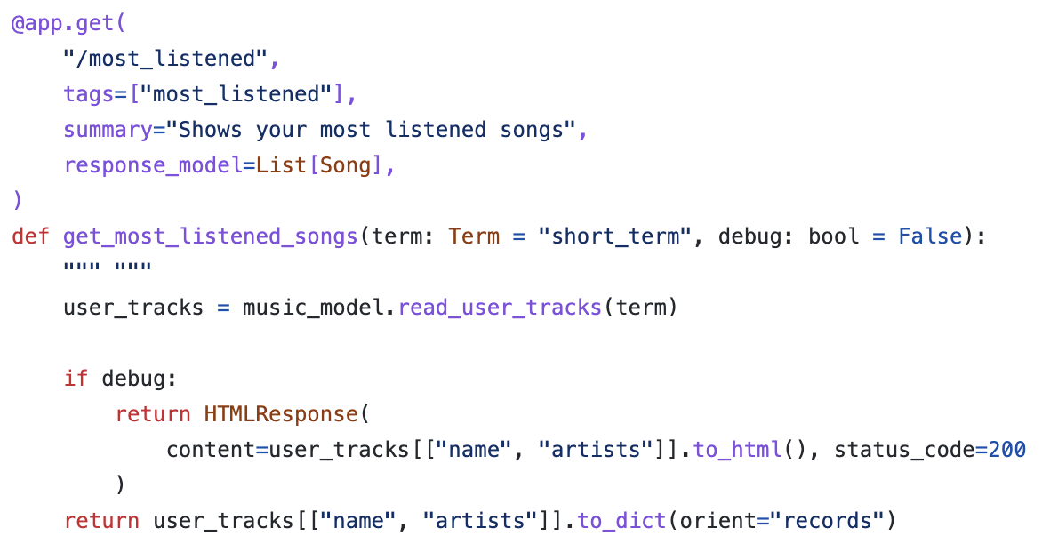
Query parameters
20220628 - A Deep Dive into Containerized Model Serving with FastAPI

Slide 33
Query parameters
20220628 - A Deep Dive into Containerized Model Serving with FastAPI

Slide 34
Interactive docs
20220628 - A Deep Dive into Containerized Model Serving with FastAPI

Slide 35
Exercise 2
Get your most listened songs by calling ‘most_listened’ with different values for the variable query variable term.
Try the functions in the interactive docs
Add a ‘limit’ parameter to get_most_listened_songs, limiting the number of records it returns.
20220628 - A Deep Dive into Containerized Model Serving with FastAPI

Slide 36
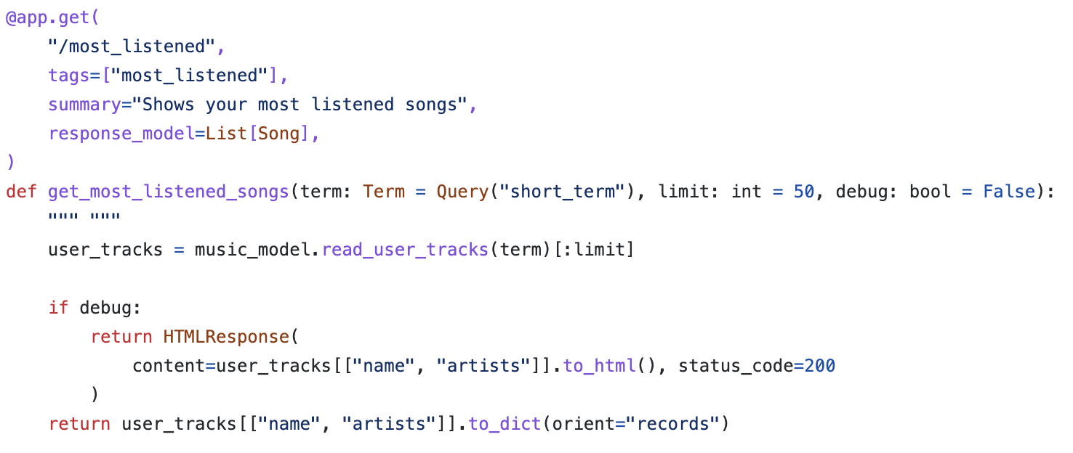
Solutions
Add a ‘limit’ parameter to get_most_listened_songs, limiting the number of records it returns:
20220628 - A Deep Dive into Containerized Model Serving with FastAPI

Slide 37
Part 3: Response model & Error handling
A request body is sent from the client to the API. A response body is the data from your API to the client.
For calls containing a request body, POST is the most common request.
To declare a request or response body, you can use Pydantic; which comes pre-installed with FastAPI.
20220628 - A Deep Dive into Containerized Model Serving with FastAPI
Notes:
Source: https://fastapi.tiangolo.com/tutorial/body/

Slide 38
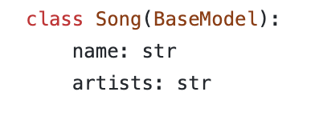
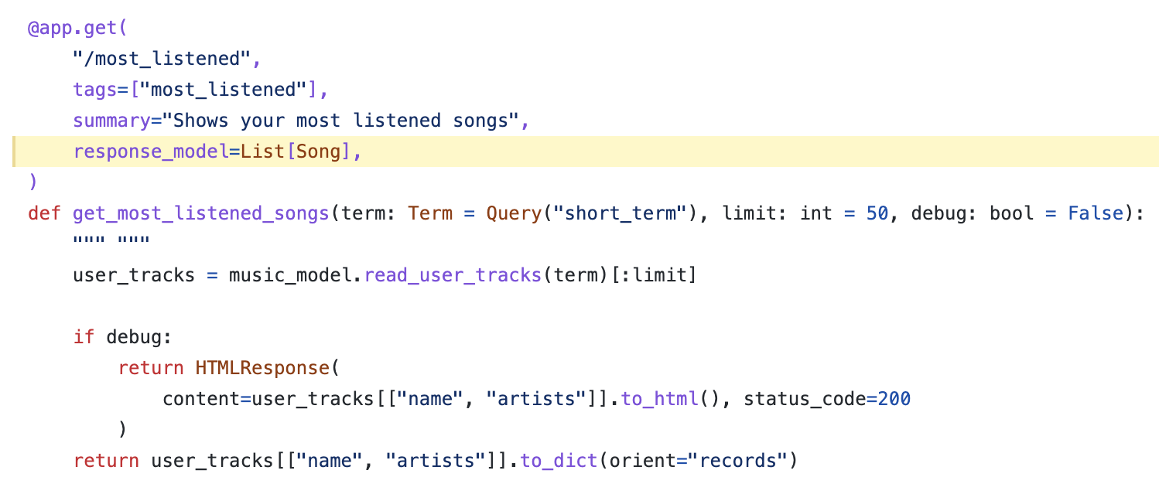
Response model
20220628 - A Deep Dive into Containerized Model Serving with FastAPI

Slide 39
Response model
20220628 - A Deep Dive into Containerized Model Serving with FastAPI

Slide 40
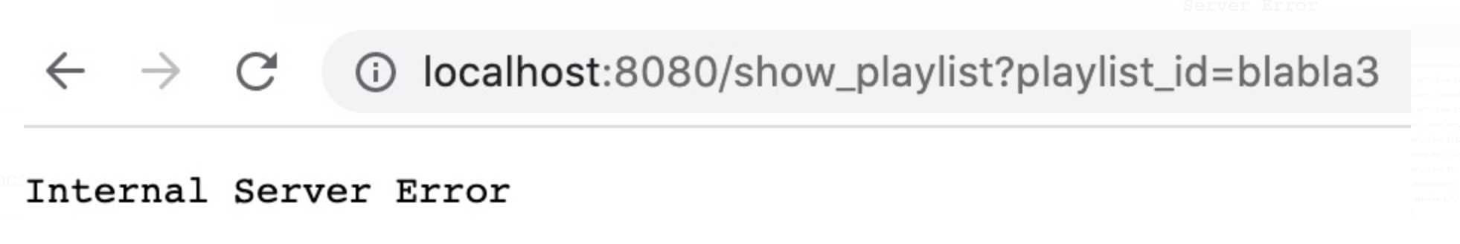
Error handling
20220628 - A Deep Dive into Containerized Model Serving with FastAPI

Slide 41
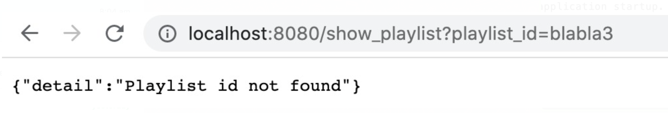
Error handling
20220628 - A Deep Dive into Containerized Model Serving with FastAPI

Slide 42
Exercise 3
Create your own prediction function with term and playlist_id as input.
Create your own PyDantic class definition for the predicted output
Bonus: Throw an HTTP error when the user attempts to ask for a playlist when no Spotify credentials are provided
Looking for an extra challenge? Try adding a function that adds your recommended song to one of your own playlist. This function still needs to be added to the MusicModel class in ‘spotify.py’
20220628 - A Deep Dive into Containerized Model Serving with FastAPI

Slide 43
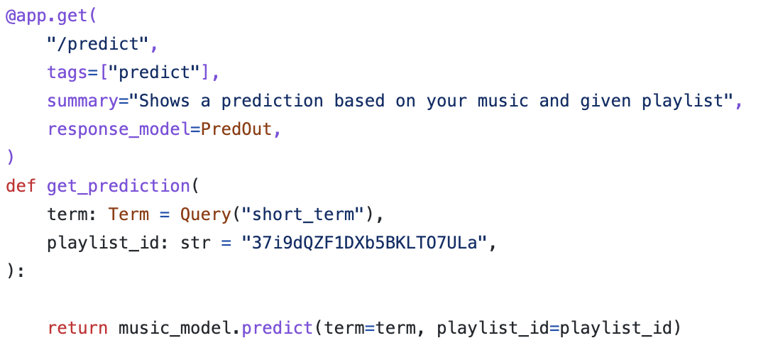
Solutions
Create your own prediction function with term and playlist_id as input.
20220628 - A Deep Dive into Containerized Model Serving with FastAPI

Slide 44
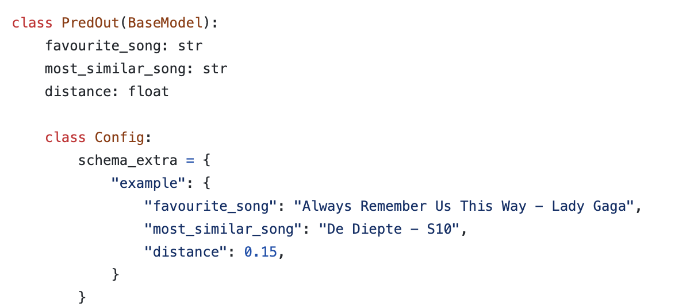
Solutions
Create your own PyDantic class definition for the predicted output
20220628 - A Deep Dive into Containerized Model Serving with FastAPI

Slide 45
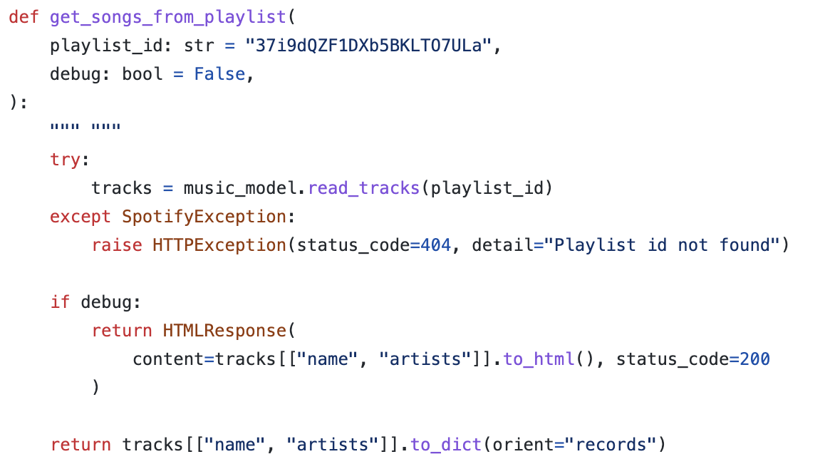
Solutions
Bonus: Throw an HTTP error when the user attempts to ask for a playlist when no Spotify credentials are provided
20220628 - A Deep Dive into Containerized Model Serving with FastAPI

Slide 46
Recap
How to use docker with a docker file
FastAPI is great for type checking, interactive docs and easy API development
How to use the Spotify Web API
More questions? Connect to us on LinkedIn!
https://www.linkedin.com/in/karlijn-schipper-889538111/
https://www.linkedin.com/in/nikki-van-ommeren-43a806a2/
20220628 - A Deep Dive into Containerized Model Serving with FastAPI

Slide 47
Questions?
20220628 - A Deep Dive into Containerized Model Serving with FastAPI

